Slide 1
Ancient River Civilization

Slide 2
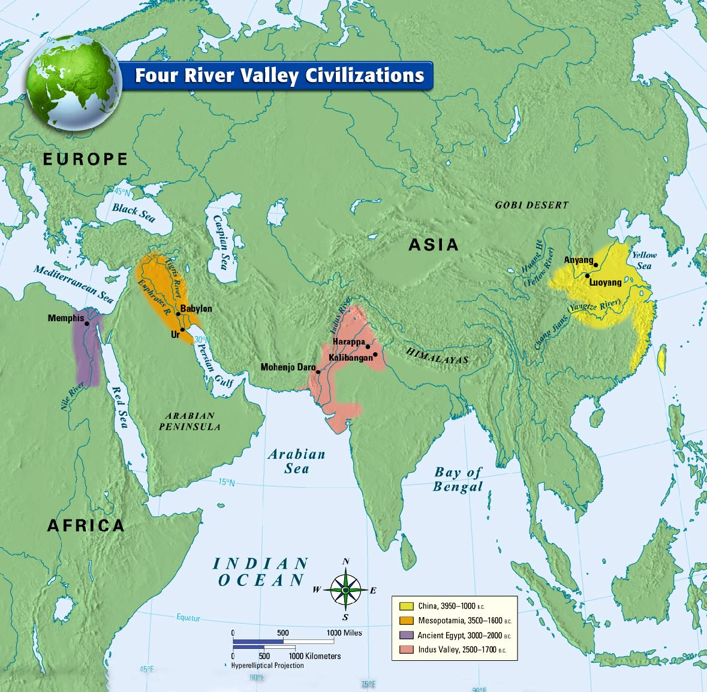
Maps of Ancient River Civilization

Slide 3
Ancient River Valley Civilizations
Early government ruled by either one individual or council elder.
Polytheistic Religion ( meaning many gods)
Early systems of writing
Developed a surplus of food, began to specialize in other jobs.
Barter economy ( trading goods for goods)

Slide 4
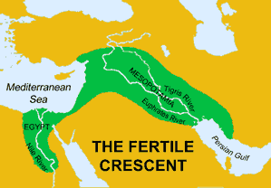
Mesopotamia

Slide 5
1. Mesopotamia
- “ Land between two Rivers ”
Area located in the Middle East
Fertile Crescent region- area of fertile land between the Tigris and Euphrates Rivers
First Civilization – Sumerians
System of writing - Cuneiform ( wedge-shaped writing)
Hammurabi’s Code (1st written law code)
“Eye for an Eye”

Slide 6
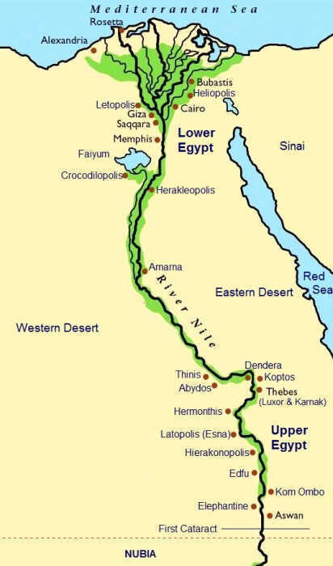
Ancient Egpyt

Slide 7
2. Egypt
located in North Africa
settled along the Nile River
Polytheistic religion
Egyptian ruler was known as a Pharaoh ( also a god)
System of writing known as Hieroglyphics
Built pyramids that served as tombs for the pharaohs and later for wealthy individuals

Slide 8
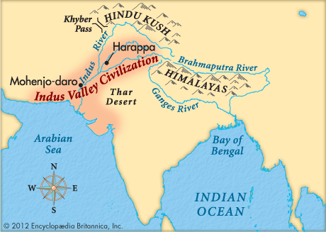
Indus River Valley Civilization

Slide 9
3. Indus River Valley
located in India along the Indus River Valley
Two main cities- Harappa and Mohenjo-Daro
Monsoons- seasonal winds that brought rain in spring and summer, brought dry air in Fall and Winter
Complex cities with grids and sewage.

Slide 10
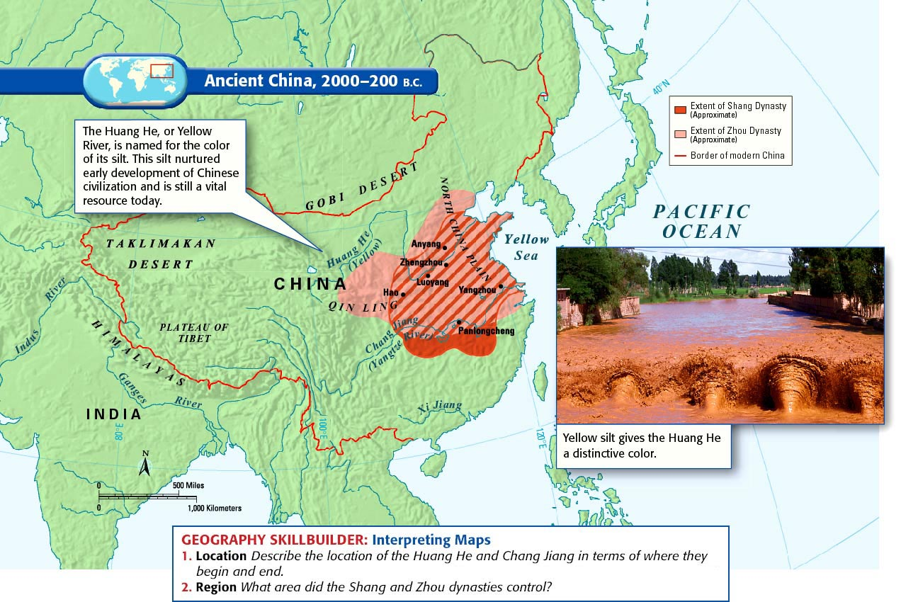
Chinese River Valley Civilization

Slide 11
4. China
located along the Huang He or Yellow River
Developed dynasties to rule China ( Tang and Song Dynasties)
Mandate of Heaven - need the approval of god to rule over the people
Development of the Silk Road - (Trade Route)
opened up trade with the west. As a result, new Chinese goods moved West and Western goods flowed into China
( Resulted in Cultural Diffusion)

Slide 12
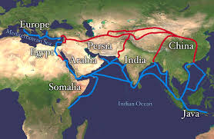
Silk Road What role does it play?

