Slide 1
Gupta Dynasty

Slide 2
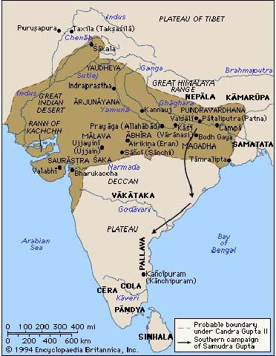
Gupta Empire Overview.
Gupta Empire came to power in India in 320 CE.
Ended in 550 C.E.
Facilitated the strengthening of Hinduism as a religion in India.
Known as the “Golden Age” of India.

Slide 3
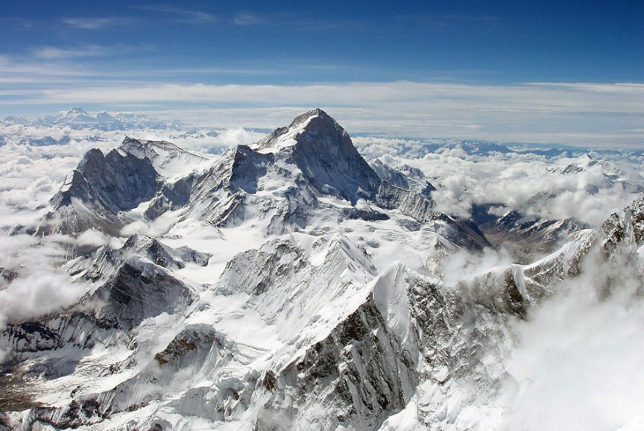
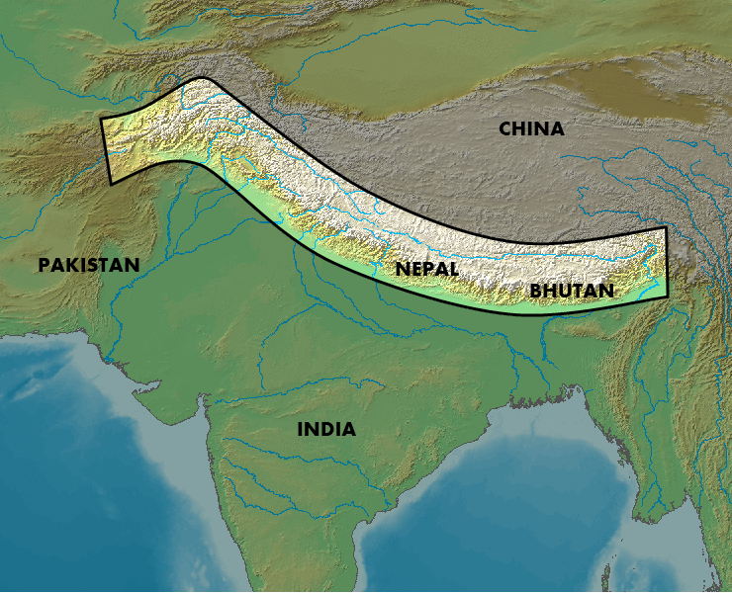
Geography
Gupta Empire rose in the North of India and spread southward.
The Himalayas and Kush mountains helps protect the civilization from invaders.
The Ganges and Indus rivers provided water and fertile soil.
Hot and Humid climate with monsoons.

Slide 4
Government
Gupta emperor ruled over a court in Pataliputra.
Very efficient central government.
Allowed Trade to prosper because of a stable background.
Local leaders had power.
In each village they had a headman and council to make decisions.
Women first could serve on council ( YAYYY!!!!)….Then restriction by Hindu law excluded their participation
( BOO!!!!)

Slide 5
Caste System.
No Movement up and down the System in your life time.

Slide 6
Village and Family Life.
Village Life
Family Life
Cluster of homes surround by fields for farming.
Village ran their own affairs with little interference from empire as long as they pay taxes.
Ran by caste system which created stability
Wealthier person lived in joint families where all the family shared a home.
They were Patriarchal, which means the eldest male was the leader.
Arrange marriage of children.
Only marry within their own caste.

Slide 7
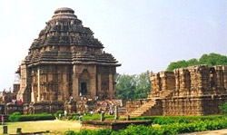
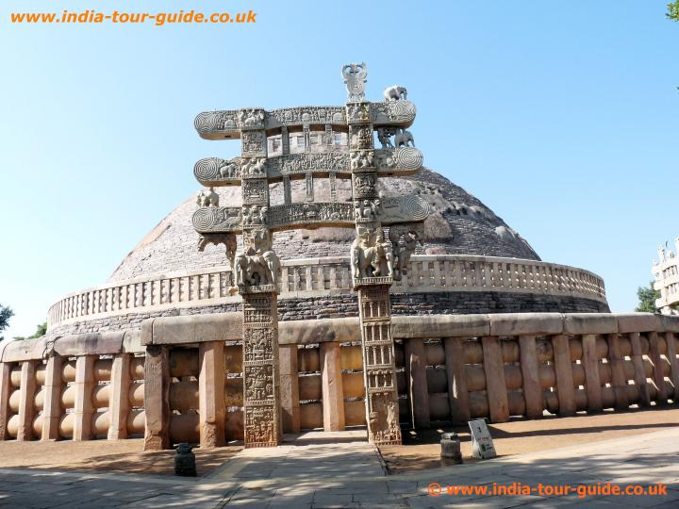
Scientific and Artistic Contributions.
Architects built stone temples for worships and Buddhist build stupas.
Science
Artistic
Education took place in Hindu and Buddhist school.
Student learned math, medicine, physics languages.
Indian Mathematics developed the concept of 0 and decimal system.
Surgeons vaccinated people from smallpox .

Slide 8
Brochure Assignment
You will create a Brochure which will be create in or to entice people to come to the Gupta Empire.
1st Panel –Title panel
2nd Panel-The Geography
3rd Panel-The Government Explained ( a biography of one Emperor with 3 facts)
4th Panel-Explanation of Hinduism and the Caste System.
5th Panel- Some Negative aspects of being in the Gupta Empire.
There should be one drawn image on each Panel with an explanation of what you are displaying.

