Slide 1
Why study history?
History Helps Us Understand People and Societies
History Helps Us Understand Change and How the Society We Live in Came to Be
The Importance of History in Our Own Lives
History Contributes to Moral Understanding
History Provides Identity
Studying History Is Essential for Good Citizenship
History Is Useful in the World of Work

Slide 2
5 Themes of History
1. Social
2. Political
3. Innovations
4. Cultural
5. Economics
Social
Political
Innovations
Cultural
Economics

Slide 3
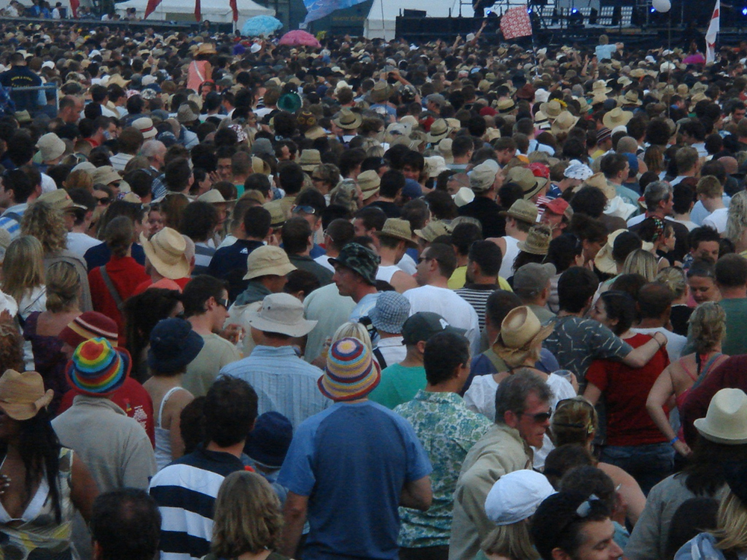
Theme 1: Social
Of or relating to human society and its modes of organization
Social classes; social problems; a social issue

Slide 4
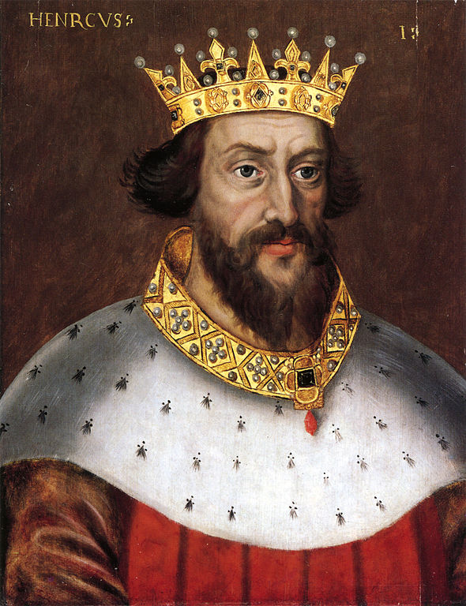
Theme 2: Political
Of, relating to, or dealing with the structure or affairs of government, politics, or the state

Slide 5
Theme 3: Innovations
A creation (a new device or process) resulting from study and experimentation

Slide 6
Theme 4: Cultural
The totality of socially transmitted behavior patterns, arts, beliefs, institutions, and all other products of human work and thought

Slide 7
Theme 5: Economics
The science that deals with the production, distribution, and consumption of goods and services, or human welfare

